Slide 1
Decoupling Synchronization from Communication is Key to Continued Scaling of Indoor Wireless Sensors
Brad Campbell & Pat Pannuto
University of Michigan
Recommender: Prabal Dutta

Slide 2
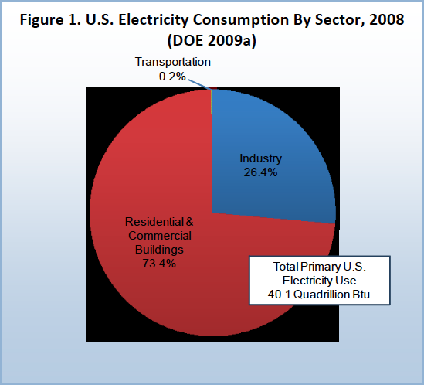

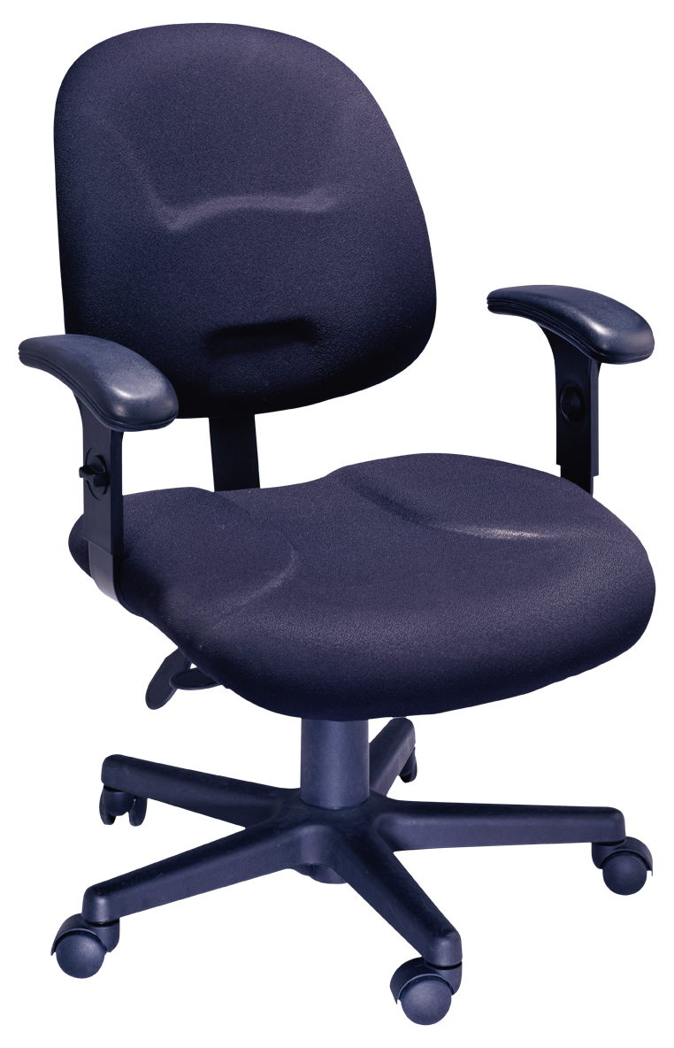


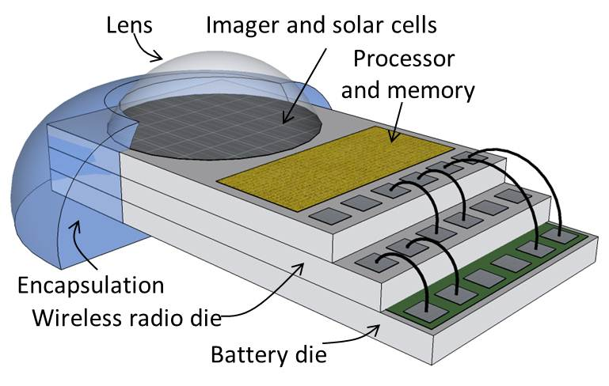
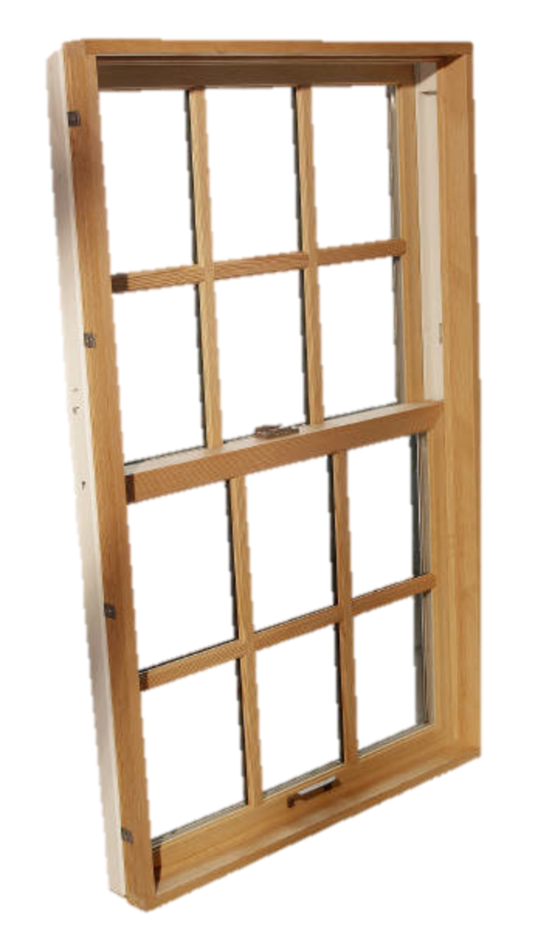
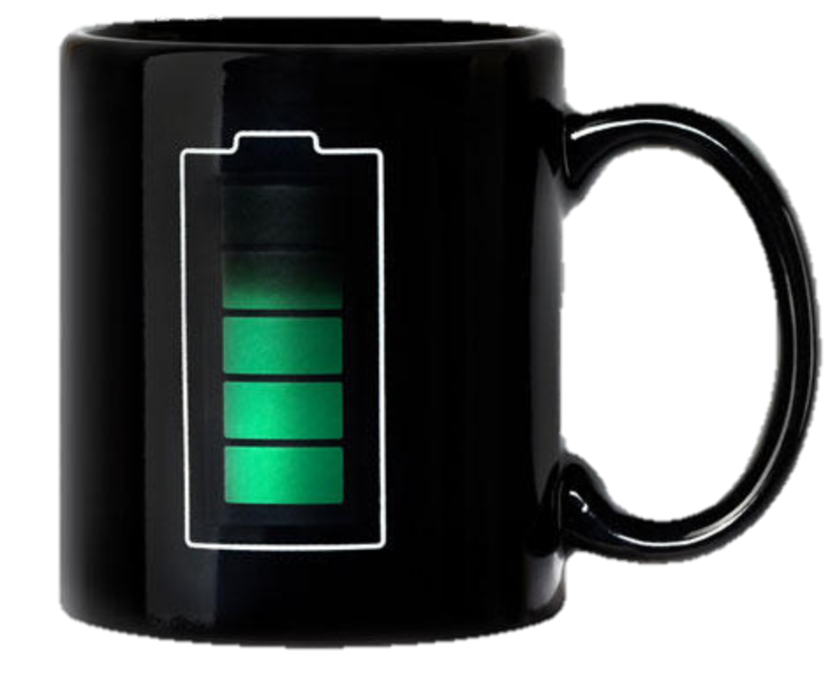
Current Building Energy Consumption Is Not Sustainable
“If current trends continue, by 2025 buildings worldwide will be the largest consumer of global energy, more than the transportation and industry sectors combined.”
50% buildings to be net-zero energy by 2050
Need instrumentation to make this happen
This is the Internet of Things
“A national goal has been set to achieve net-zero energy in 50% of U.S. commercial
buildings by 2050 (DOE 2010).”
measure everything
Michigan Micro Mote (M3)
Net-Zero Energy, High-Performance Green Buildings – NSTC - 2008
Measurement Science Roadmap for Net-Zero Energy Buildings – NIST Technical Report 2010
2
Notes:
Mug pic source: http://www.luuux.com/node/3285797
----- Meeting Notes (2/26/13 15:33) -----
Change this slide.
Make it more clear what the problem is and the intro to how we want to solve it.
What is the gentlest way to get them on the same page as you?

Slide 3
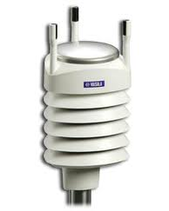
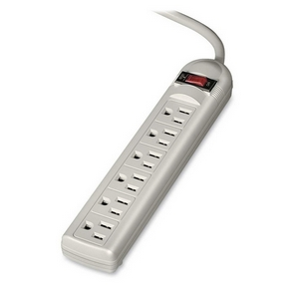
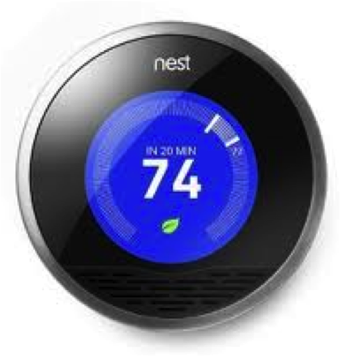
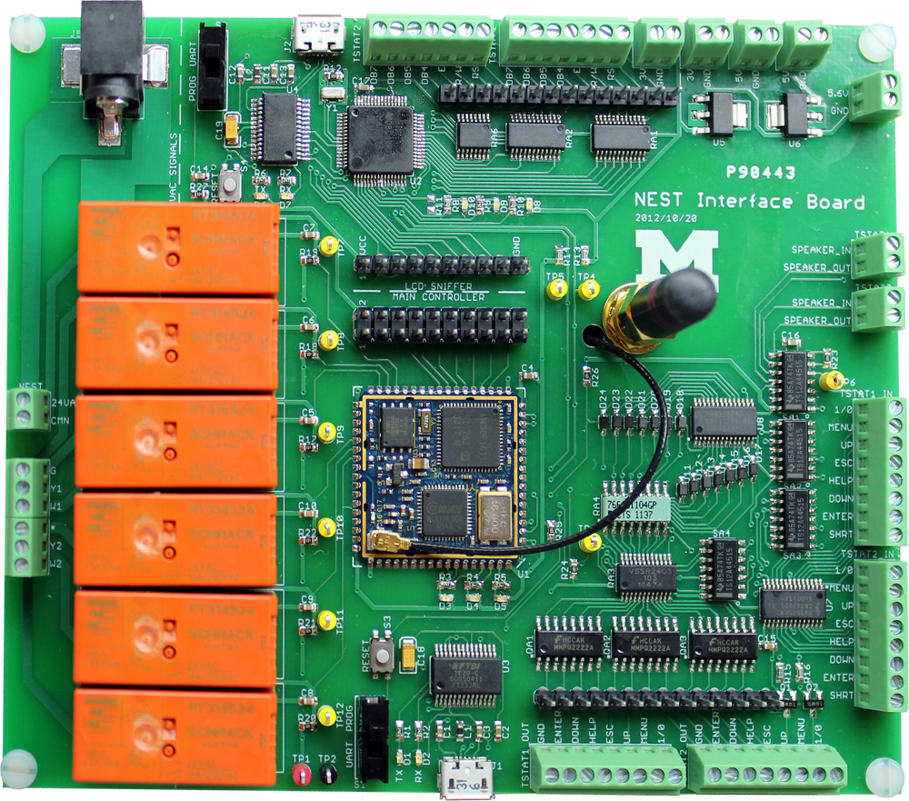



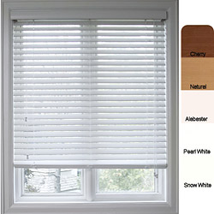
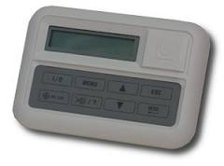
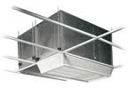
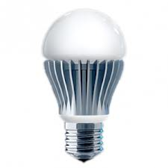


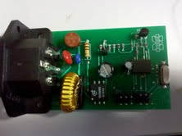
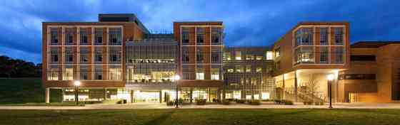
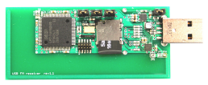
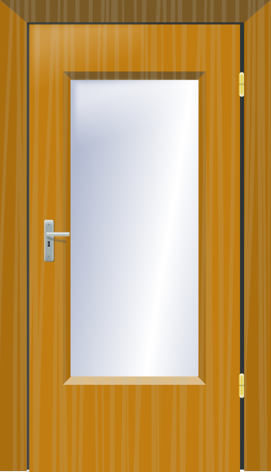

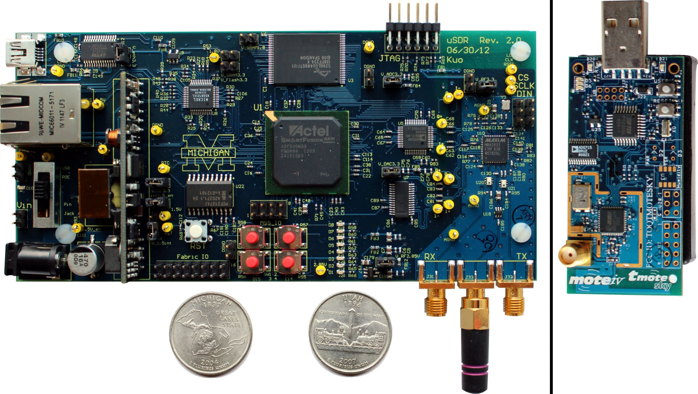
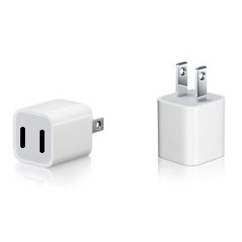
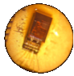
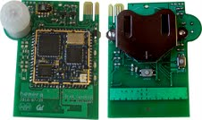
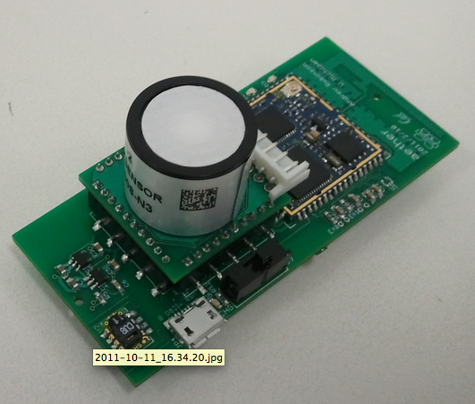
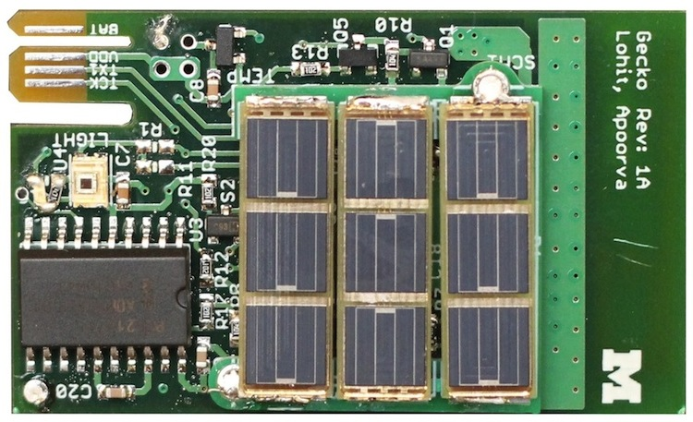
Pervasive Networks Make This Possible
Weather
Lights
AC
Blinds
Interface
PLC
Liebert
Mini-Mate
RDS
15.4
VLC
∞
Lifetime
Battery
Size
Count
Power
T/H/L/O
T/L/O
AQM
T/H/L
Notes:
Need to make scaling important

Slide 4
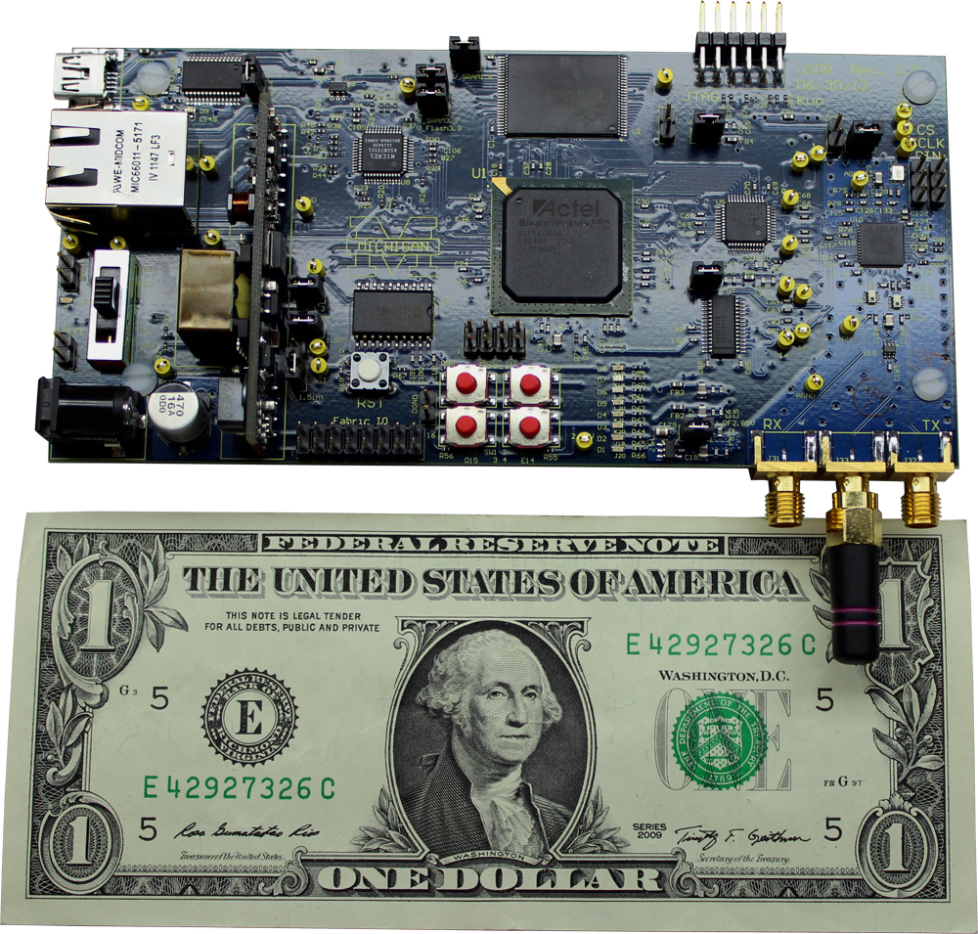
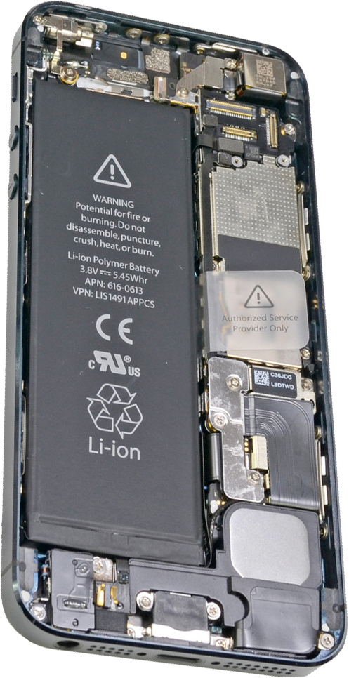
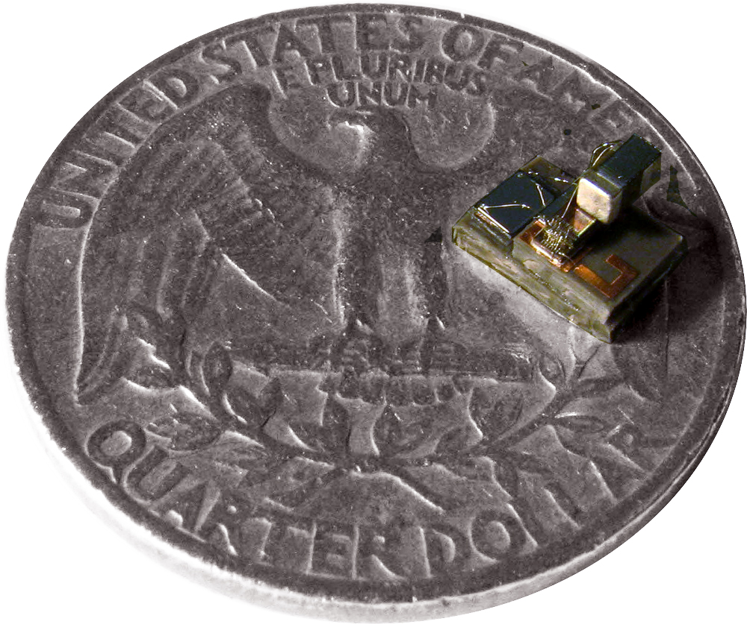
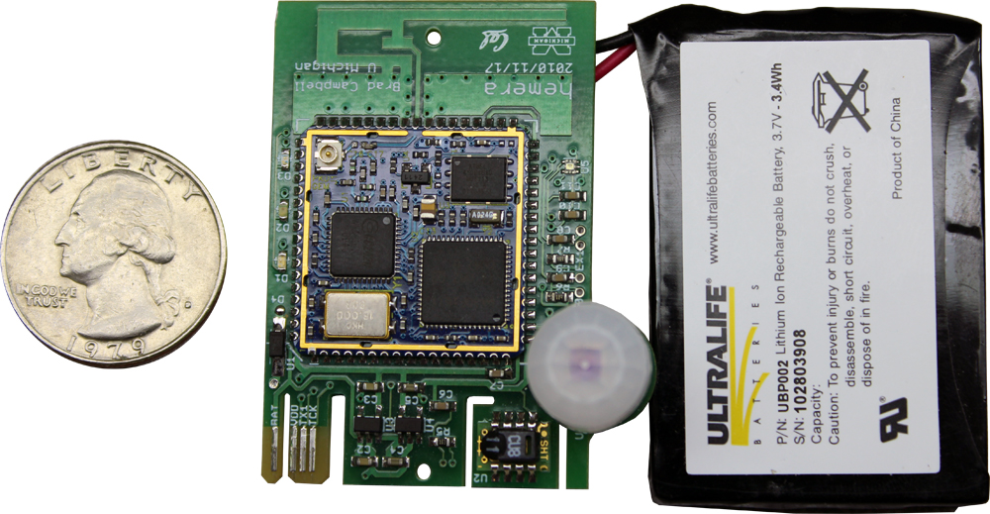
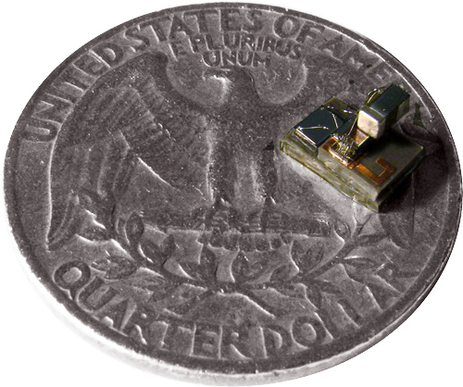
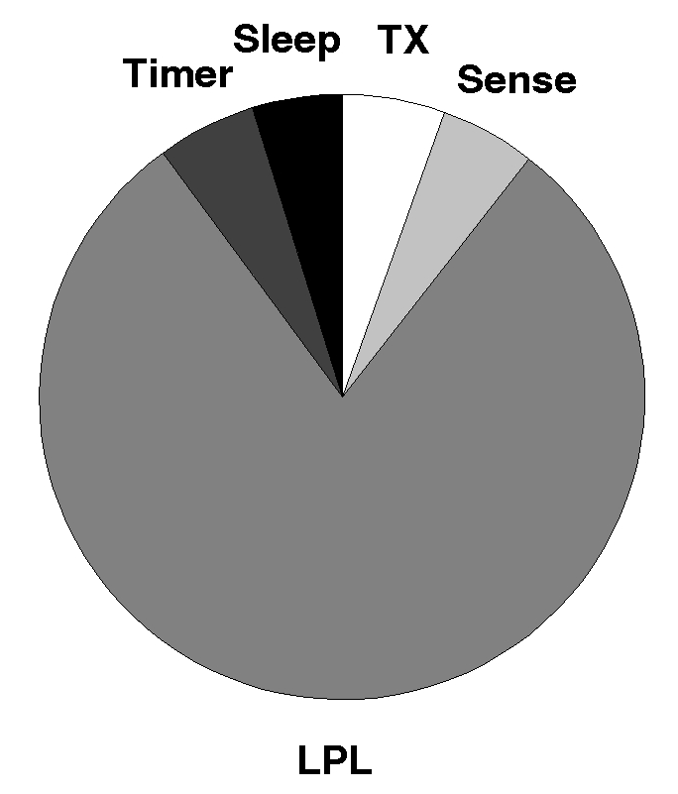
Energy Storage Dominates Volume
P_{AVG}=750μW DC=2%
P_{AVG}= DC=100%
P_{AVG}=21nW DC=0.2%
Low-Power Listening
(idle listening)
DC=2.2%
R. Szewczyk, A. Mainwaring, J. Polastre, D. Culler,
“An Analysis of a Large Scale Habitat Monitoring Application”,
ACM SenSys’ 04, November, 2004, Baltimore, MD
Notes:
Use animation in this slide, start with only top left box graph showing
then click in hemera
then click in M3 node on a penny
then orally admit that this thing doesn’t work
and click in M3 node with battery and caps on a quarter
Then click in the bottom two graphs
----- Meeting Notes (2/26/13 15:33) -----
Why is scaling important? <- this idea is not connected
Why aren't the large sensors good enough?
possible title: Power supply dominates node volume.
add duty cycles and power budgets for 3 nodes
----- Meeting Notes (2/27/13 13:26) -----
Focus on synchronization and comm problem with smallest node
m3: 6 microwatts * 0.2% + 9 nanowatts * 99.8% in microwatts

Slide 5
Synchronization Dominates Power Budget
Staying Synchronized
Discovery
Low Power Node
1 minute
CC2520 Radio + AM18xx RTC:
300s * 2ppm * 2 = 1.2 ms guard
1.2 ms * 60 mW = 36 μJ (RF loss)
300s * 150nW = 45 μJ (RTC loss)
≈ 100 μJ loss / packet @ 300 s
Min 1
Battery Node
(Searching)
Guard
1200 μs
@ 2ppm
Min 2
Local time
Min 3
Asynchronous Neighbor Discovery (Discoª)
Static Power:
100 nW+
FLOW over same period:
695pW * 300s = 0.21uJ
480x improvement
Discovery α (Duty Cycle)²
300 s
Real time
TX
WiseMAC ’04
B-MAC ’04
Adaptive LPL ’07
A-MAC ’10
GLOSSY ’11
LPB ‘12
Preserving Synch
α
C * (Duty Cycle)
RX
Low Power Listening¹ ‘02
(via ALOHA ‘70)
¹Hill, J.L.; Culler, D.E.; , "Mica: a wireless platform for deeply embedded networks," Micro, IEEE , vol.22, no.6, pp. 12- 24, Nov/Dec 2002
ªPrabal Dutta and David Culler. 2008. Practical asynchronous neighbor discovery and rendezvous for mobile sensing applications. In Proceedings of the 6th ACM conference on Embedded network sensor systems (SenSys '08). ACM, New York, NY, USA, 71-84.
Notes:
Thesis: Why does listening dominate power? You must listen by definition to RX data, but we currently listen very poorly, inefficiently.
If synchronization is necessary for efficient RF communication, why do we use RF communication to achieve synchronization?
Slotted ALOHA: N. Abramson. The aloha system: Another alternative for computer communications. In Proceedings of the Fall 1970 AFIPS Computer Conference, pages 281–285, Nov. 1970
B-MAC: Joseph Polastre, Jason Hill, and David Culler. 2004. Versatile low power media access for wireless sensor networks. In Proceedings of the 2nd international conference on Embedded networked sensor systems (SenSys '04). ACM, New York, NY, USA, 95-107.
WiseMAC: A. El-Hoiyi, J.-D. Decotignie, and J. Hernandez. Low power MAC protocols for infrastructure wireless sensor networks. In Proceedings of the Fifth European Wireless Conference, Feb. 2004.
Adaptive LPL: Jurdak, R.; Baldi, P.; Lopes, C.V.; , "Adaptive Low Power Listening for Wireless Sensor Networks," Mobile Computing, IEEE Transactions on , vol.6, no.8, pp.988-1004, Aug. 2007
----- Meeting Notes (2/26/13 15:33) -----
title: Synchronization Dominates Power Budget
guard time graph
add science
the science story is there, we need to add it

Slide 6
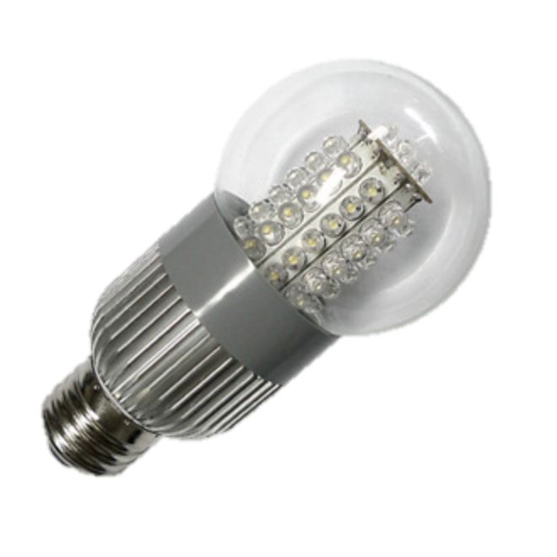

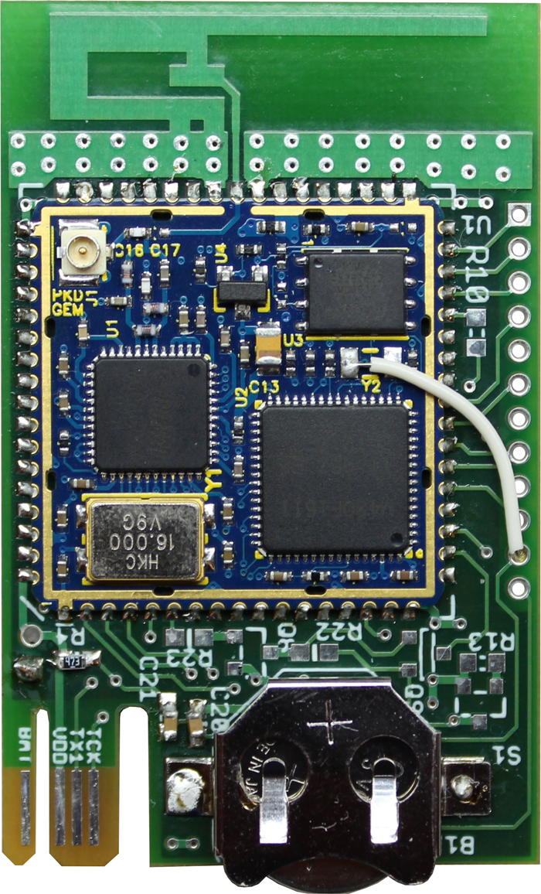

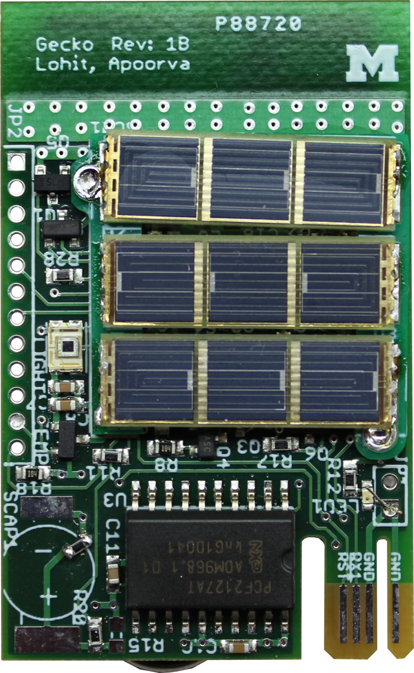

Key Insight: Decouple Synchronization from Communication
External synchronization
Ambient 60 Hz wave
Sudden change in room lighting, or a noise
Provide it efficiently?
Idea: Use visual light as wake-up channel for synchronization
Synchronization and time-keeping burden is shifted to infrastructure
Notes:
Light bulb: http://www.future-lamp.com/upfile/ledbulb/ZHKL-B60AD.JPG
Wavy arrow: http://www.google.com/imgres?hl=en&safe=off&tbs=itp:clipart&tbm=isch&tbnid=ZqZ_6dOyj2dEmM:&imgrefurl=http://www.clipartguide.com/_pages/0808-0710-1114-2232.html&docid=tSMLsKR9eo1hYM&imgurl=http://www.clipartguide.com/_small/0808-0710-1114-2232.jpg&w=300&h=300&ei=CjEsUdmzB-nM2gWRu4DwBQ&zoom=1&ved=1t:3588,r:0,s:0,i:86&iact=rc&dur=2527&sig=111116956587821697691&page=1&tbnh=187&tbnw=175&start=0&ndsp=33&tx=132&ty=88&biw=1676&bih=956
Radio Waves: http://www.clker.com/clipart-radio-waves-black.html
Listen: http://www.buzzle.com/images/cliparts/symbols/listen.jpg
----- Meeting Notes (2/26/13 15:33) -----
Title: Key Insight: Decouple Synchronization from Communication
move title to bullet
"There are bunch of things we could do, but lets pick light bulbs"
"Move burder on synch to infrastructure."
Similar to what mobile phones do
Sync over:
- 60 hz
- lights turning on
- in case of light bulbs, just provide one
Comm. over:
- rf?
-
----- Meeting Notes (2/27/13 13:26) -----
high frequency led signal unperceptible

Slide 7
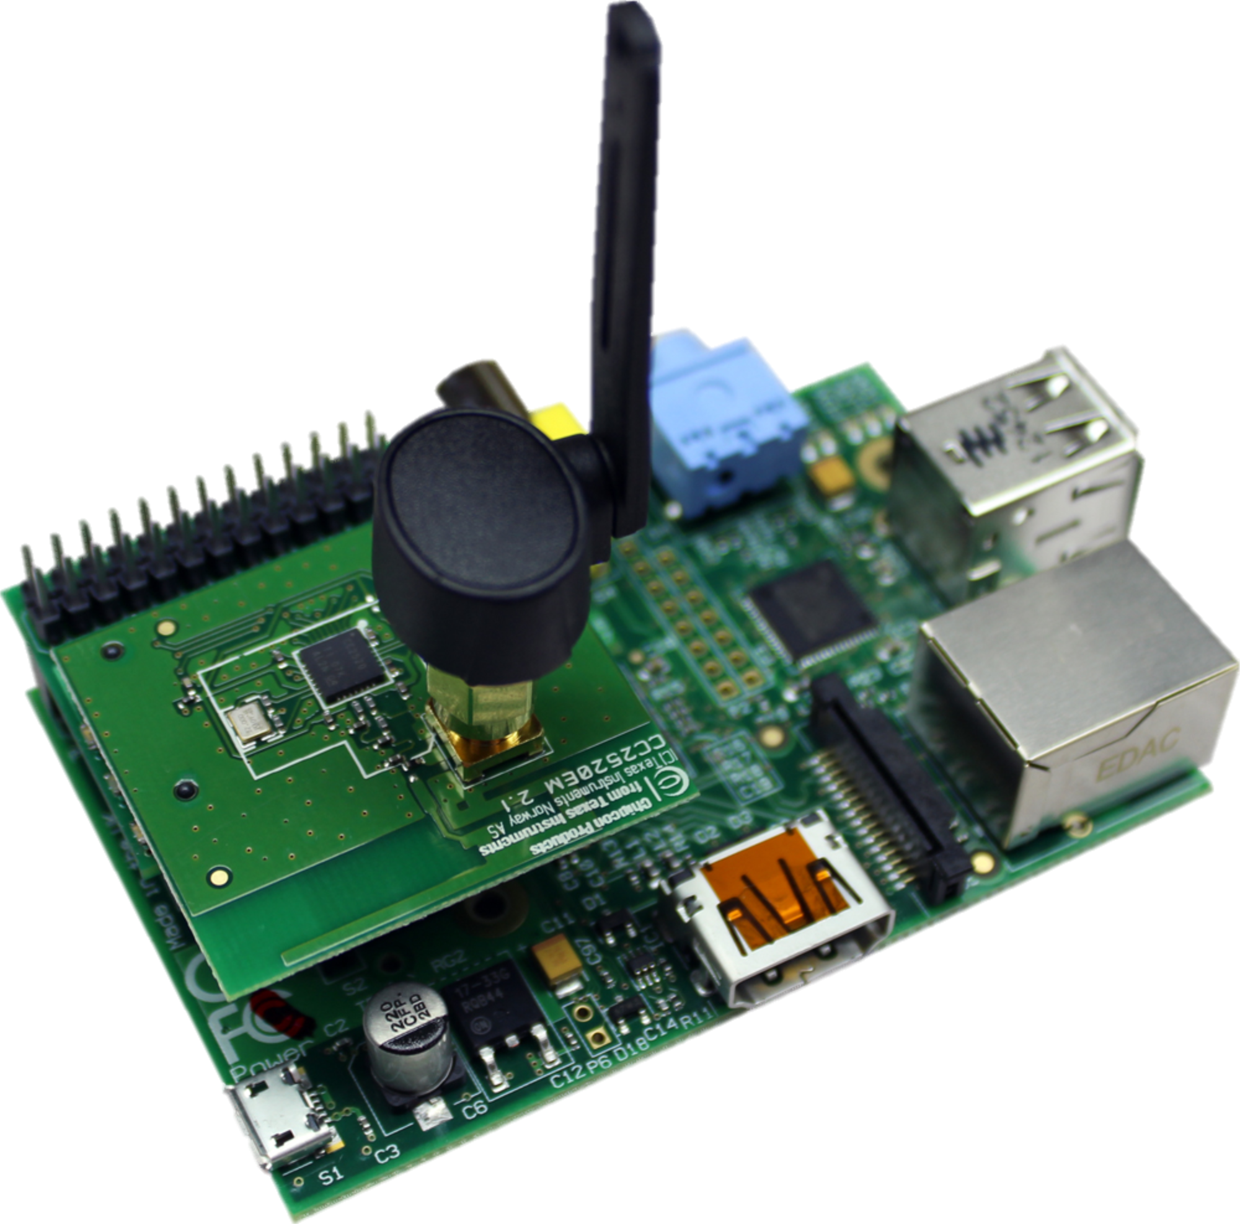
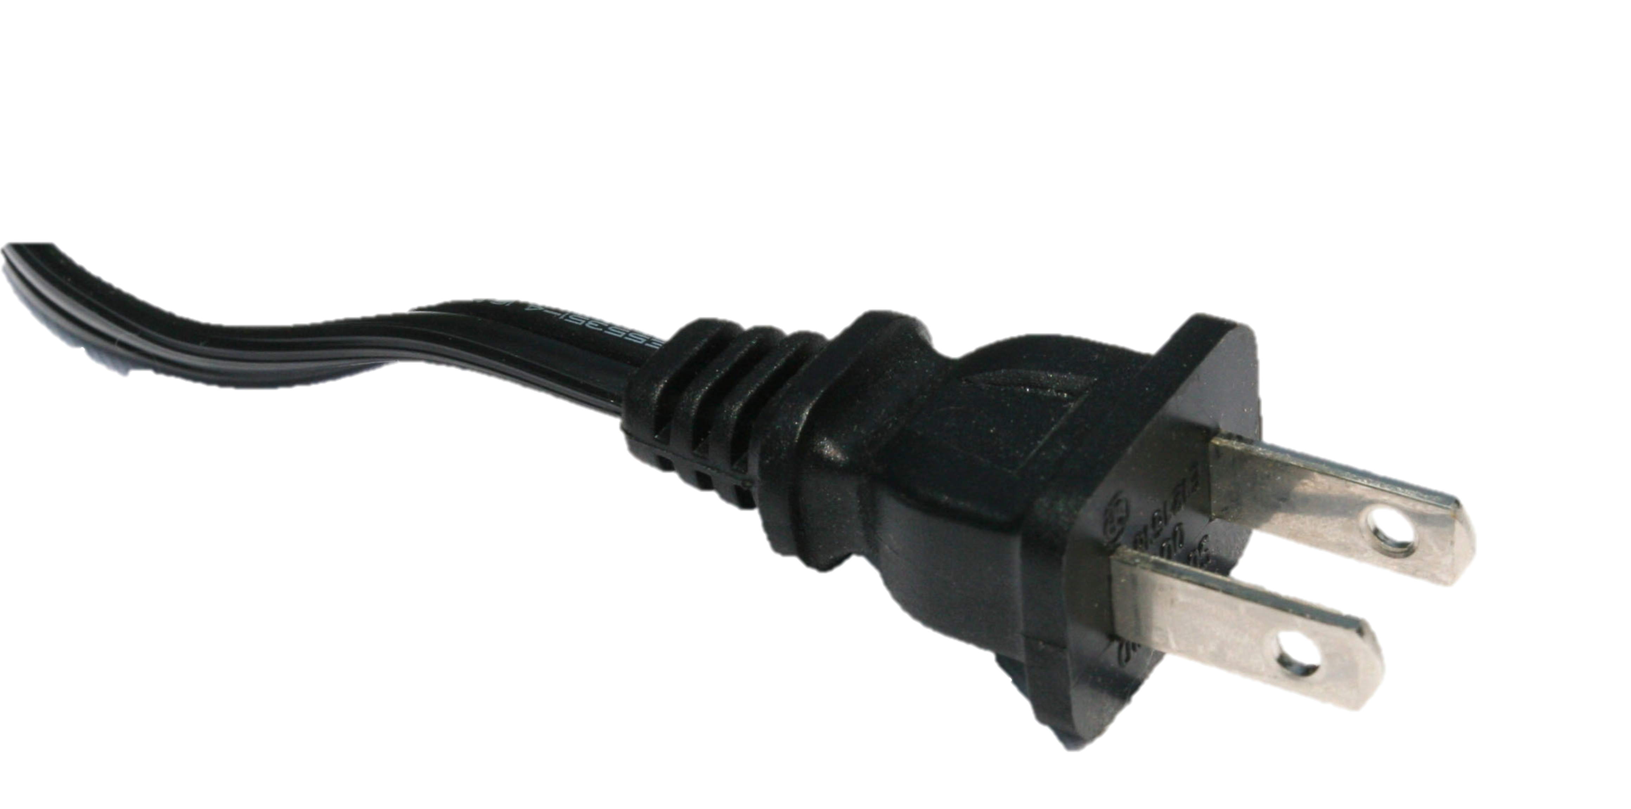
Enabling Smart Dust for the Smart Building
The Internet
Backbone Communication
Synchronization
Medium
Border Router
IPv6 ↔ 6LoWPAN
Bridges multiple physical layers
Enables nodes with 480x lower idle power
Wireless Communication
Notes:
Point: NOTHING needs batteries. What is the point of having a network where any node requires maintenance; this reduces the whole network to requiring maintenance
----- Meeting Notes (2/26/13 15:33) -----
Notes: what power budgets are we enabling? what is the effect of our system? where does it get us?
See boxes off-slide on the right on slide 5 for derivation of 480x number

Slide 8
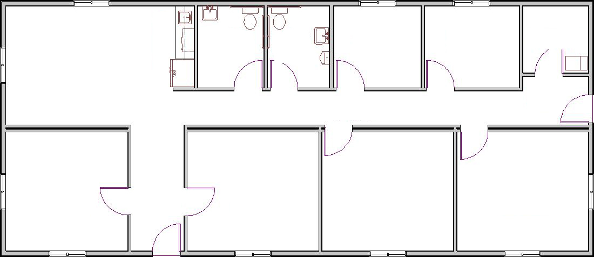

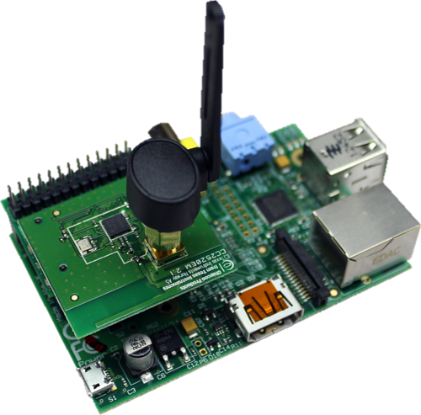
The Smart Building as a Platform
Synchronization backbone
Location auto-configuration
Data collection
External asynchronous interrupts
Notes:
----- Meeting Notes (2/26/13 15:33) -----
add wireless mesh as backbone, it doesnt really matter "well just go with plc"
"maybe you could manually add locations for lightbulbs"
"but we have techniques for doing autoconf location"
make first pkt with more hops
"take advantage of path loss and use multi hops." "we can do this because we don't have idle listening." "may be necessary for lp nodses"
"optical wake up reciver enables async interrupts"
write down the section headings that this system enables
- data collection
- external async interrupts
----- Meeting Notes (2/27/13 13:26) -----
new example not coffee

Slide 9
The Smart Building as a Platform
The Programmable Building
Triggers:
On Room.Exited by Person as P:
If Room.Occupancy is 0:
Room.Blinds.Close()
Room.Lights.Off()
Room.HVAC.UnMix(P.PreferredHVAC)
On Room.Entered by Person as P except {P in Janitors}:
Room.HVAC.MixIn(P.PreferredHVAC)
Rules:
Room.HVAC.Bound( ± 10° relative to Building.Average)
Notes:
----- Meeting Notes (2/26/13 15:33) -----
mention the goal

Slide 10
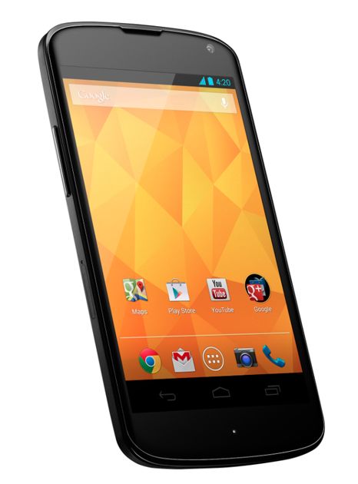


What Else Does the Smart Bulb Infrastructure Provide?
Where am I?
Where am I?
Indoor
localization:
Proximity Based Events:
Notes:
Indoor Localization
Mobile phone that can self-locate indoors
Automatic WiFi Access based on physical proximity

Slide 11
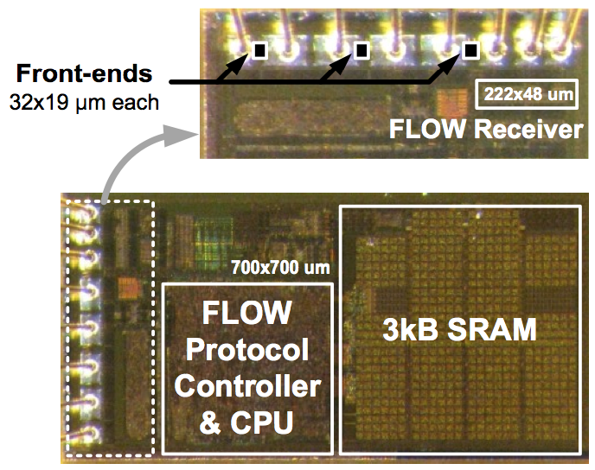
We Have (very) Low Power Visible Light Wakeup
FLOW: 695 pW Optical Wake-up Receiver
Gyouho Kim, et. al, "A 695 pW standby power optical wake-up receiver for wireless sensor nodes," Custom Integrated Circuits Conference (CICC), Sept. 2012
And Nodes That Run on Indoor Photovoltaic*
*Except for a battery powered RTC
Lohit Yerva, Brad Campbell, Apoorva Bansal, Thomas Schmid, and Prabal Dutta. 2012. Grafting energy-harvesting leaves onto the sensornet tree. IPSN '12.
Notes:
----- Meeting Notes (2/26/13 15:33) -----
Change citation to paper
title: "And Nodes that Run on IPV (Indoor Photovoltaic)
feel: "Elements to build the architecture"
"We have components to explore the architecture in order to validate the architecture"

Slide 12
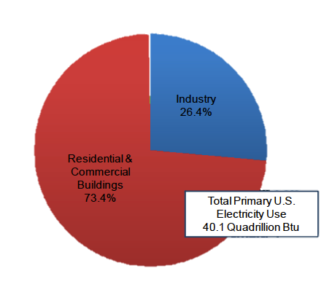
Realizing the Smart Building
API
Low-Power Listening
(idle listening)
DC=2.2%
Brad Campbell & Pat Pannuto
Recommender: Prabal Dutta
Notes:
Spoken: “When we take care of the disproportionate cost of listening <click> by decoupling synchronization from communication with an external synchronization source <click> to build building-wide mesh networks <click> with a smart API on top, <click> we can finally do something about that. Thank you and we’ll take any questions.”

